Slide 1
Third week update (Dataset Fairness)
Yueyang Qin
Koganti Sri Harsha

Slide 2
Relevance
Is the use of ML in this context solving an appropriate problem?
Help people to think about the fake news have been detected, and be more careful about the content that have been expressed. Instead of just follow what president or news said.

Slide 3
Representativeness
Is the data used to train the ML models appropriately selected?
The training and testing dataset are in the suitable amount.

Slide 4
Value
Does the machine learning model produce predictions that are more accurate than alternative methods? Does it explain variation more completely than alternative models?
It won’t be 100% accuracy, but will be much helpful and explain variation than alternative models. First need to choose the right dataset.
Do the predicted values inform human decisions in a meaningful way? Are they actionable? Are they timely? Are they delivered to the right people?

Slide 5
Explainability
How effectively is the use of machine learning communicated?
It is important to explain to the root people how the outcome be reasonable, without let them learn how the deep model do the work.

Slide 6
Auditability
Can the model’s decision-making processes be queried or monitored by external actors?
It is important that the outputs can be monitored externally to show that the model is fair, unbiased, and does not harm some users.

Slide 7
Equity
If used to guide decision-making, has the ML model been tested to determine whether it disproportionately benefits or harms some individuals or groups more than others?
It is important that the outputs can be monitored externally to show that the model is fair, unbiased, and does not harm some users.

Slide 8
Accountability / Responsibility
If used to guide decision-making, are there mechanisms in place to ensure that someone will be responsible for responding to feedback and redressing harms, if necessary?
An accountable setup both makes sure that there are systems in place to prevent harmful errors and makes sure someone is responsible for and correcting errors.

Slide 9
Demographic parity
In this case, the fake news detection is considered the source is equal.
For example, Source based Fake News Classification (https://www.kaggle.com/ruchi798/source-based-news-classification)
The dataset source from ”News”, “politics news”, “Government News”, “left-news”, “US_News”, “Middle-east”, “World news”.
Others like “News source date”, “News source Location”, “News type”, …etc

Slide 10
Fairness through unawareness
a (hypothetical) task-specific metric for determining the degree to which individuals are similar with respect to the classification task at hand;
an algorithm for maximizing utility subject to the fairness constraint, that similar individuals are treated similarly.

Slide 11
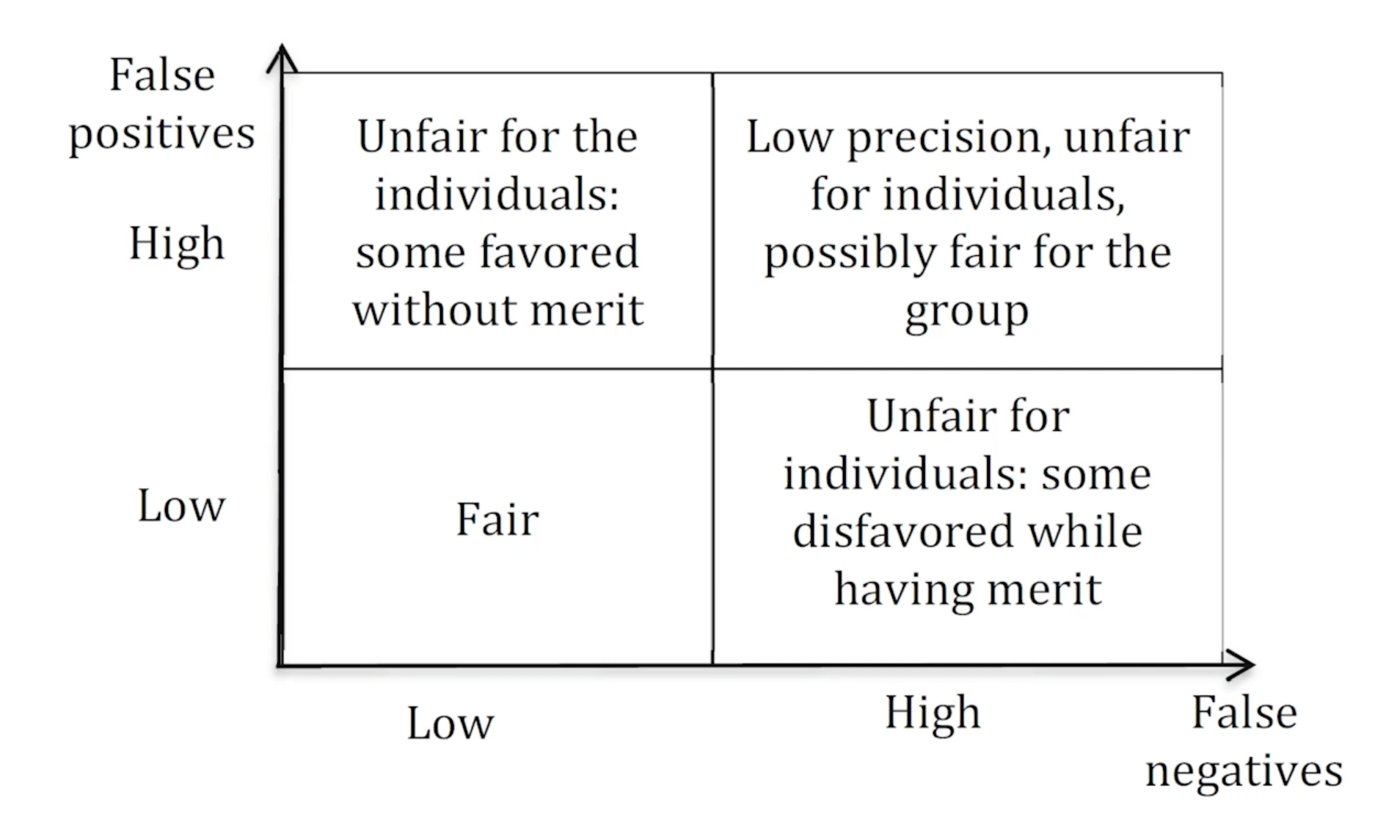
Confusion matrix

Slide 12
Equality of odds
The false positive and true positive rates should be the same for both fake news and true news.

Slide 13
Some dataset
https://github.com/KaiDMML/FakeNewsNet
https://www.kaggle.com/ruchi798/source-based-news-classification
https://github.com/nguyenvo09/EMNLP2020
https://www.kaggle.com/shivkumarganesh/politifact-factcheck-data
https://hrashkin.github.io/factcheck.html
https://archive.ics.uci.edu/ml/datasets/News+Aggregator
https://archive.ics.uci.edu/ml/datasets/Health+News+in+Twitter

Slide 14
Video or file source:
https://www.borealisai.com/en/blog/tutorial1-bias-and-fairness-ai/
https://arxiv.org/abs/1104.3913
https://arxiv.org/abs/2010.04053
https://towardsdatascience.com/identifying-fake-news-the-liar-dataset-713eca8af6ac
https://journals.sagepub.com/doi/full/10.1177/0002764219878224
https://ocw.mit.edu/resources/res-ec-001-exploring-fairness-in-machine-learning-for-international-development-spring-2020/module-four-case-studies/case-study-mitigating-gender-bias

